Slide 1

Data Structures
Final Exam Study Guide

Slide 2

Grading Structure
Item | Points
Assignments | 20 – the worst assignment will be dropped
Midterm | 20
Projects | 40
Quizzes | +5 (the average of all the quizzes)
Final | 20

Slide 3
What is required for the final exam?
Exam Date/Time:
Tuesday, May 14, 3:30-5:30 p.m.
Chapters: 8, 9, 10(heap sort), 11
Topics: Binary Trees, Heaps, Priority Queues, Binary Search Trees, Self-balancing search trees, B-Trees, Maps, Sets, Hash tables.
You still need to be fairly knowledgeable on the previous data structures as well, but the focus of the final is from trees and on.

Slide 4
How to Study for the Final?
The practice exam I posted on Blackboard
The tasks (exercises) in the slides.
The quizzes.
Skim through the slides.
The textbook (summaries at the end of each chapter are good as well).
The assignments.

Slide 5
Question Types
Knowledge Questions (Weight: 20% ): 20 Multiple Choice Questions.
Understanding Questions (Weight: 25%): 2-3 questions: Topics: heaps, self-balancing search trees (e.g. build a tree, remove a node, etc.)
(Weight: 10%) A question on what data structure you would use for some requirements.
Programming Question (Weight: 20%): 1 programming questions: recursive and on binary search trees.
Algorithm Question (Weight 25%): Write pseudo code.

Slide 6

Using Data Structures
Data Structure | Usage
Priority queues/heaps | To prioritize items based on a specified priority. Don’t forget to define a Compare structure that tells your queue how to compare the items.
Self-balancing search trees e.g. AVL, red-black, 2-3 trees | Quick search, insertion, deletion (log n). Also good when you want queries (items that start with, greater than, less than, range, etc.)
Hash tables/maps | Fast access if key is known. Fast insertion O(1) on average. Allow you to link objects by means of ids rather than references. Not good for queries.
B-Trees | Like search trees, but is more suited for storing large amounts of data on an external disk.

Slide 7
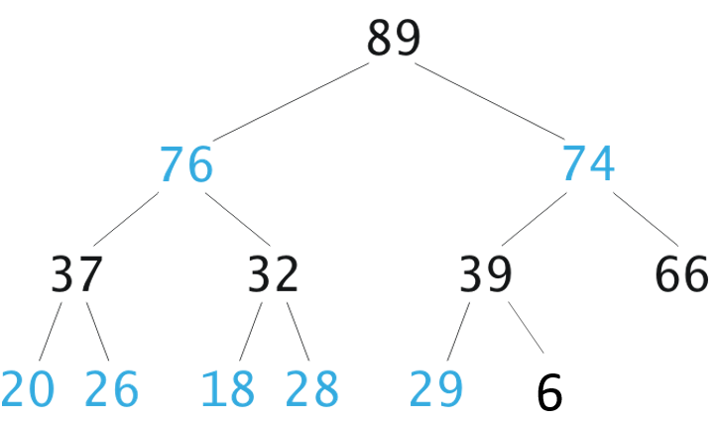
Removing an Element from a Heap
6
76
6
37
26
6
6

Slide 8
Building an AVL Tree
+2
+2
+1
0
1, 18, 14, 16, 19, 30
1
+1
+1
-1
+1
0
0
+2
18
14
0
0
0
0
0
+1
0
0
-1
0
1
0
14
18
+1
+1
0
0
0
0
0
16
19
14
0
0
0
0
1
16
30

Slide 9
Building a 2-3 Tree
5, 18, 14, 16, 19, 20

Slide 10
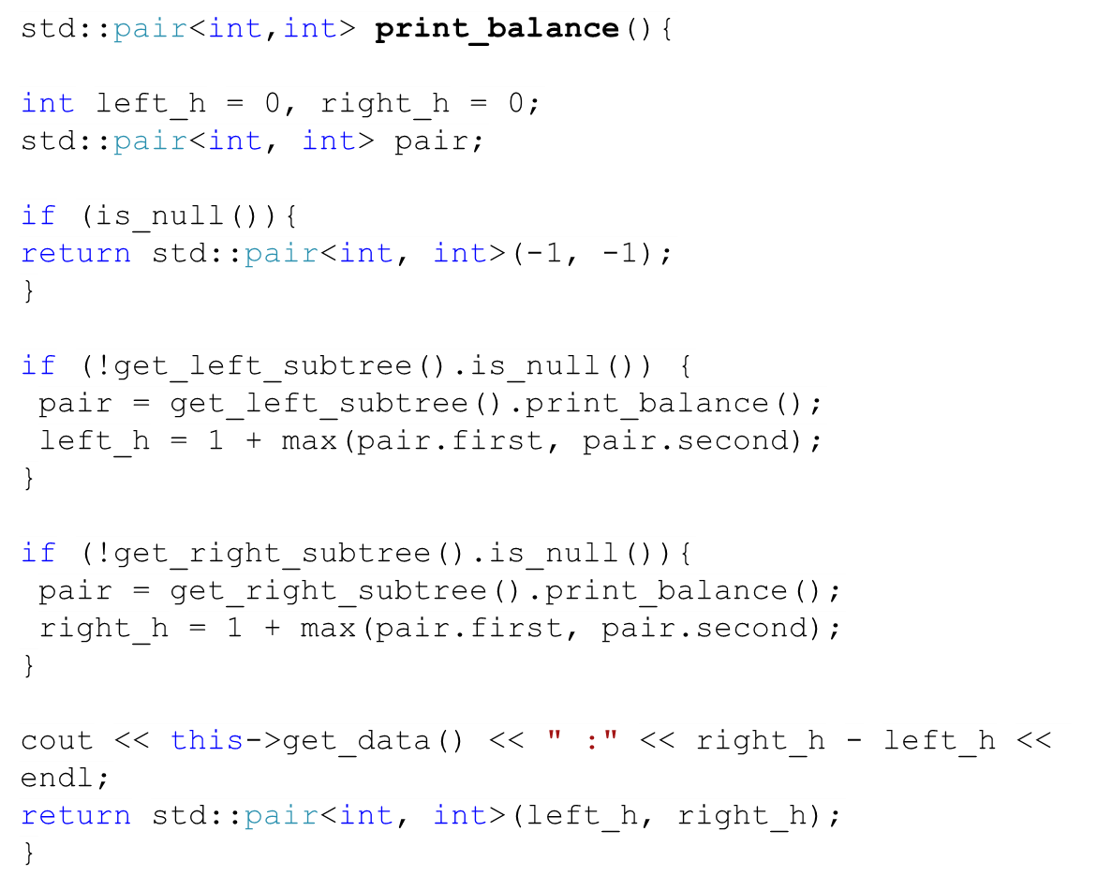
Print the Balances of a Binary Tree
14
{1,3} 2
{0,0} 0
1
{1,2} 1
18
{0,0} 0
{0,1} 1
16
19
{0,0} 0
30
called
finished

Slide 11
The Bookstore System (1)
A bookstore keeps track of the books it sells. Each book receives reviews from clients that bought the books. The bookstore wants to build a system that keeps track of the books and their reviews.
The system should help the staff find a book efficiently by its ID (e.g. ISBN). Furthermore, the system should allow the staff to query the reviews a book received. For instance, it should be fairly efficient to find all the reviews a book has received since the date: May 1, 2000.
Assumptions: (1) A book has a name and a title. (2) A review has a rating (a scale from 1 to 10) and a date. Let’s assume that the date is unique for each review.
System
1
has books
*
Book
1
keeps track of a history of orders
*
Review

Slide 12
The Bookstore System (1)
1. What abstract data structure would you use to keep track of books? Why?
System
The fact that we want to find books efficiently based on their IDs, maps are best for that.
1
has books
*
Book
2. What abstract data structures would you use to book keep track of the history of a book reviews? Why?
1
We should use a self balancing search tree (e.g. AVL trees) since we need to perform special queries based on order that go beyond finding an item by key. Since we also want to maintain an ordered collection of books.
keeps track of a history of orders
*
Review

Slide 13
The Bookstore System (2)
3. Modify the minimal class diagram (Figure 3) so that it shows the data structures that you will use to keep track of the objects of the classes (e.g. orders, employees).
System
1
1
Map<String, Book>
Book
has books
*
*
Book
1
Book_Store
Review_Tree
1
keeps track of a history of orders
*
Review
Review
*
AVL_Tree<Review>

Slide 14
The Bookstore System (3)
4. Write pseudo-code algorithms for calculating the number of reviews after a given date (e.g. 1/1/1998) :
1/1/90
3/1/80
1/1/2000
5/5/70
3/10/2001
1/1/99
5/10/2002
11/11/97

Slide 15
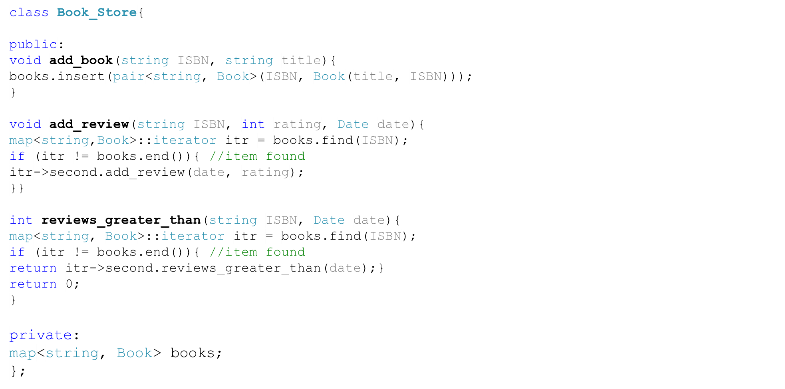
The Bookstore System (4)

Slide 16
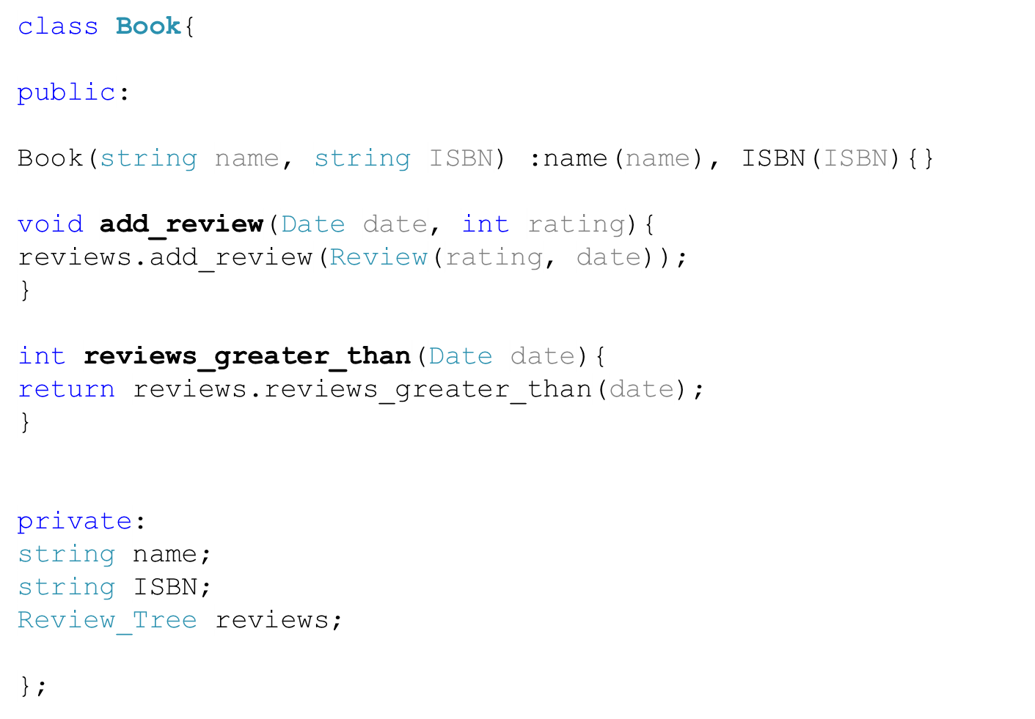
The Bookstore System (5)

Slide 17
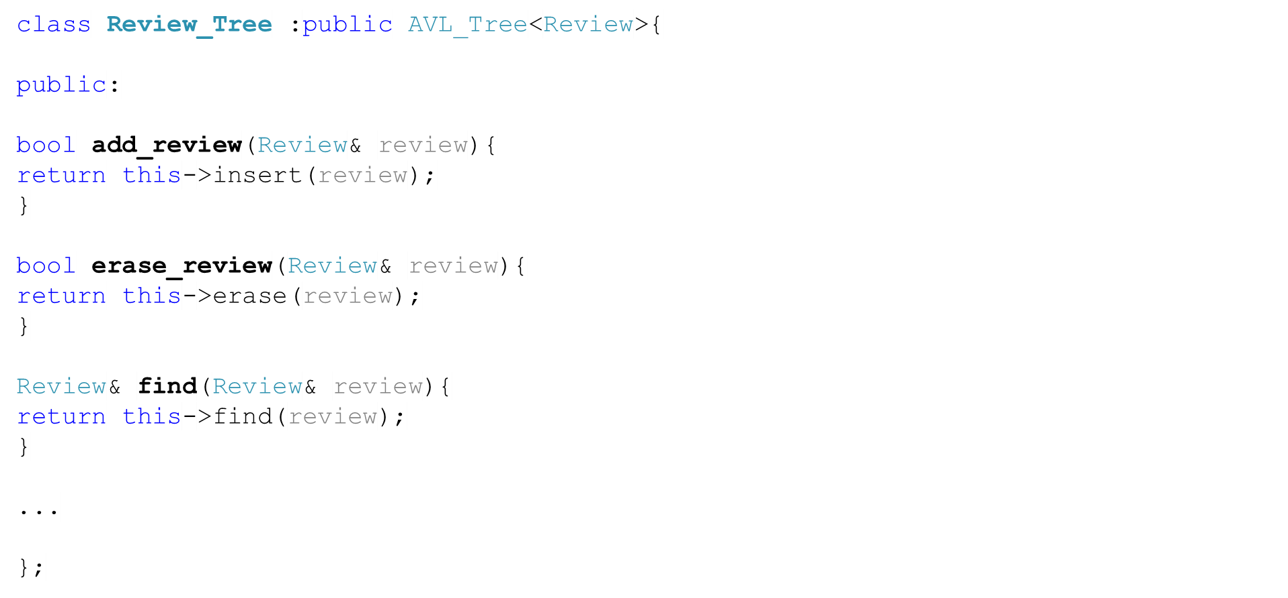
The Bookstore System (6)

Slide 18
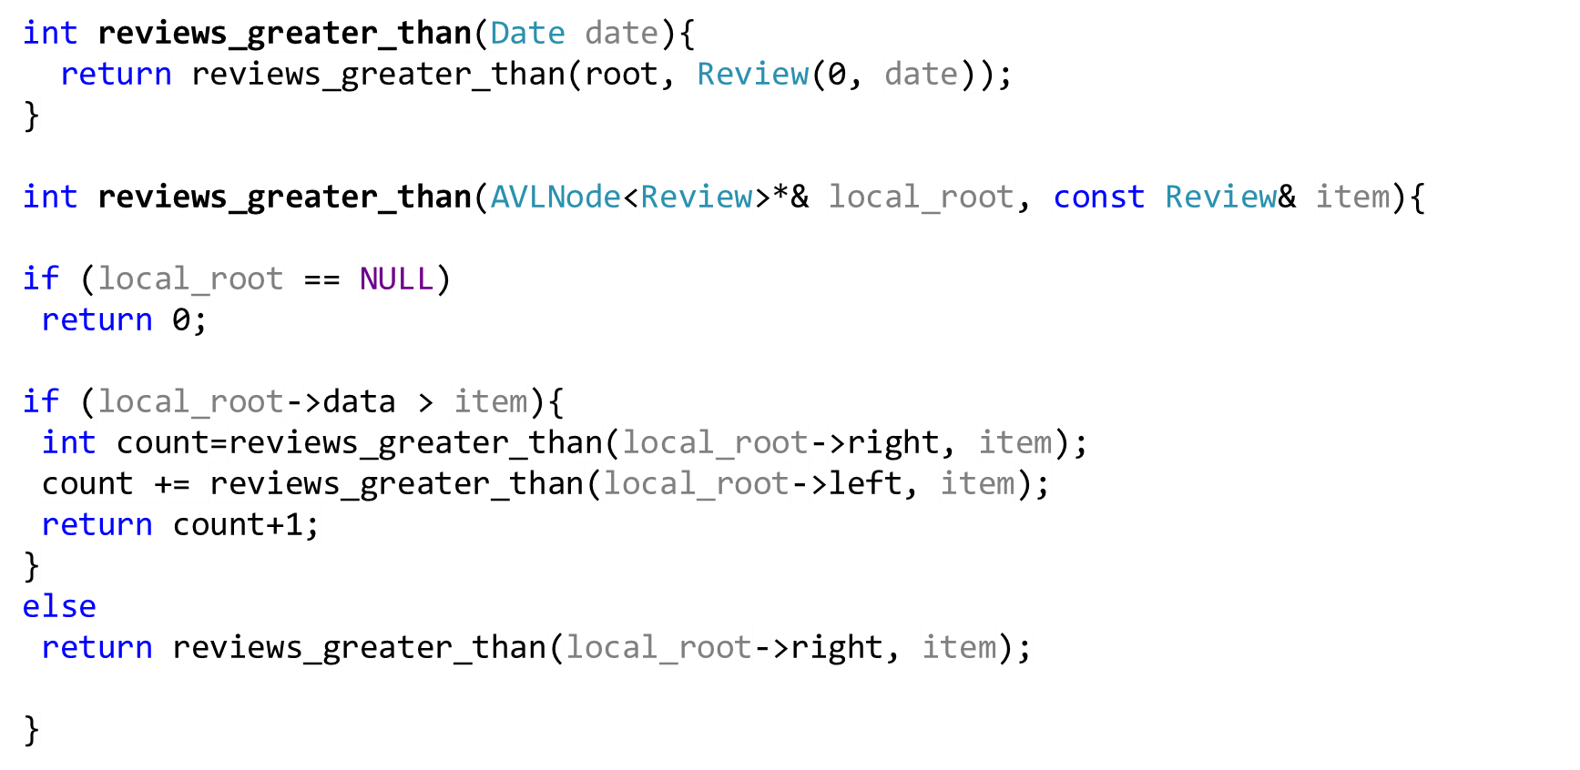
The Bookstore System (7)

Slide 19
Review Questions (1)
Write an algorithm that merges two balanced binary search trees. The result should also be a balanced binary search tree.
11
50
?
9
13
20
51
10
52
12

Slide 20
Possible Solution
Convert both trees into sorted arrays
Merge the two arrays into one sorted array
11
50
9
13
20
51
10
52
12
9 | 10 | 11 | 12 | 13
20 | 50 | 51 | 52
9 | 10 | 11 | 12 | 13
20 | 50 | 51 | 52

Slide 21
Possible Solution
9 | 10 | 11 | 12 | 13
20 | 50 | 51 | 52
3. Convert the sorted array into a binary search tree
13
50
10
20
51
9
11
12
52

Slide 22
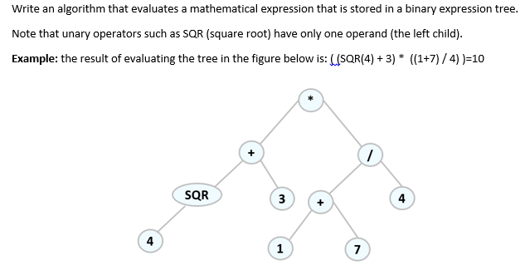
Review Questions (4)

Slide 23
int evaluate(Node local_root){
If(is_operator(local_root->data)){
if(is_binary(local_root->data)){
return eval_op(evaluate(local_root->left), evaluate(local_root->right), local_root->data);
else if(is_unary(local_root->data))
return eval_unary_op(evaluate(local_root->left),local_root->data);
}
else if(is_operand(local_root->data)
return local_root->data;
else
throw std::exception(“invalid character”);
}

Slide 24
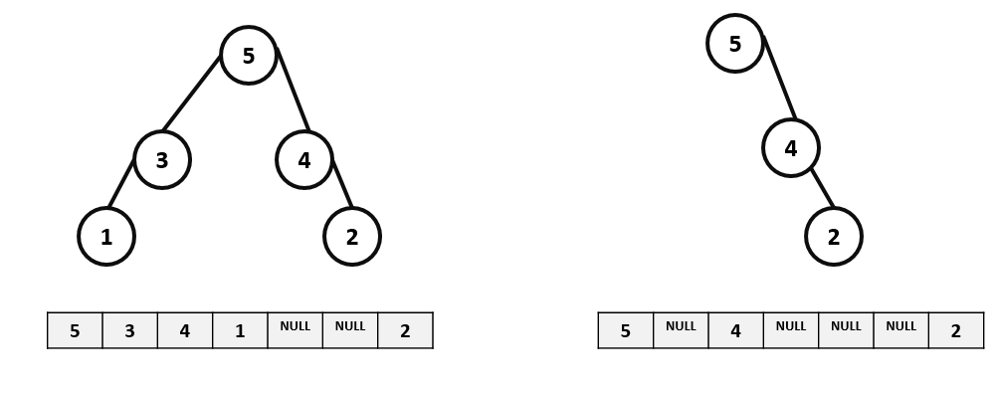
Task
Write an algorithm that converts a node-based binary tree into an array-based binary tree. For instance, the trees in Figure 5 correspond to the arrays underneath them. You may assume that you know the height of the tree as well as the number of items.
Note: In a array-based binary tree, if the index of the parent is p, the index of the left child is: 2*p + 1 and the index of the right child is 2*p + 2. If the index of a child is c, the index of the parent is (c-1)/2

Slide 25
Solution
int height=tree.height();
Array tree_array=Array[2^height];
for(int i=0;i<tree_array.size();++i)
tree_array[i]=NULL;
populate_array(tree.get_root(),0, array);
populate_array(Node* local_root,int index, Array array){
array[index]=local_root->data;
if(local_root->left!=NULL)
populate_array(local_root->left,2*index+1,array);
If(local_root->right!=NULL)
populate_array(local_root->left,2*index+2,array);
}

Slide 26


